Slide 1
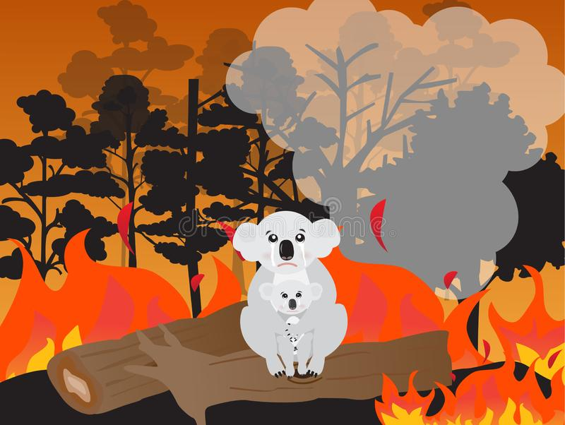
FiRescue
BY -
ANTHONY PRAJWAL
AYUSH BIHANI
DEEPTHI BHAT
KARTHIK BHAT
NISHA THOMAS

Slide 2
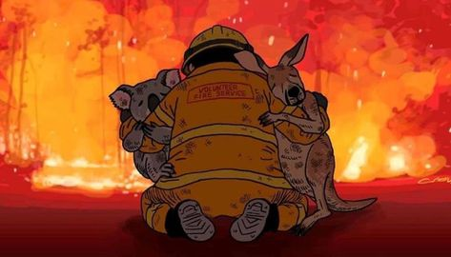
Game Play
Our trained dog agent is thrown in a forest fire simulated environment.
The aim of the dog is to save as many animals as possible from the forest fire and drop them one by one to the safe zone.

Slide 3
Unity Environment Setup
Install Unity3D (v 2018.4)
Install Python (v 3.6.1)
Install the com.unity.ml-agents Unity packages
Install the ml-agents Python package

Slide 4
Forest Simulation
To build the forest environment, we used unity standard assets.
We used this package to build trees, lakes, mountains, and grass in our forest terrain environment.

Slide 5
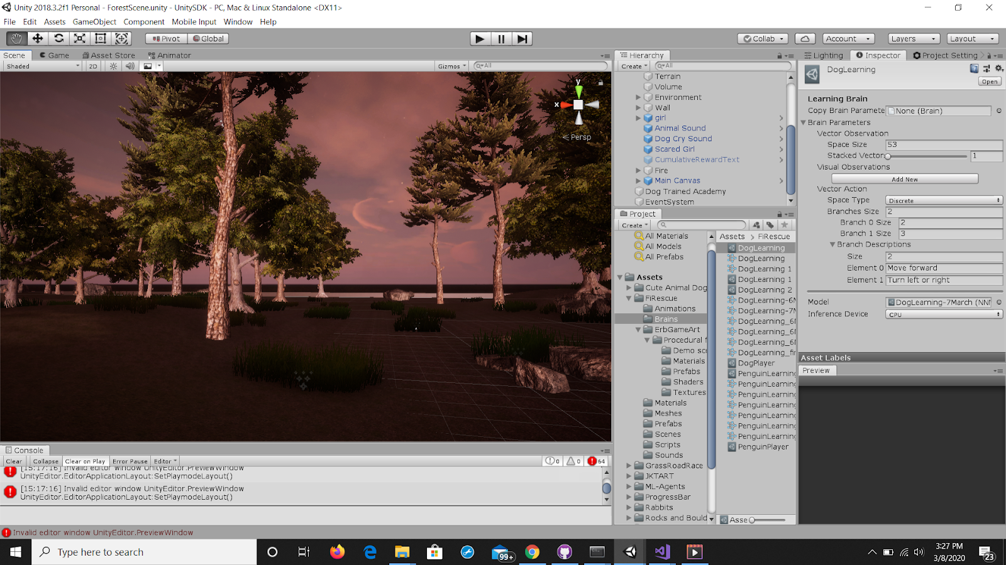

Slide 6
Agent, Animals & Fire Simulation
A dog, which is the main agent of the game, who’s responsibility is to learn to dodge fire and save animals.
Squirrels and rabbits which are the animals stuck in the forest fire and need to be saved by the dog,
To simulate fire, we used the Procedural Fire asset.
A girl, who defines the safe zone in the game.
The Dog picks up squirrels and rabbits and drops them off at the safe zone.

Slide 7
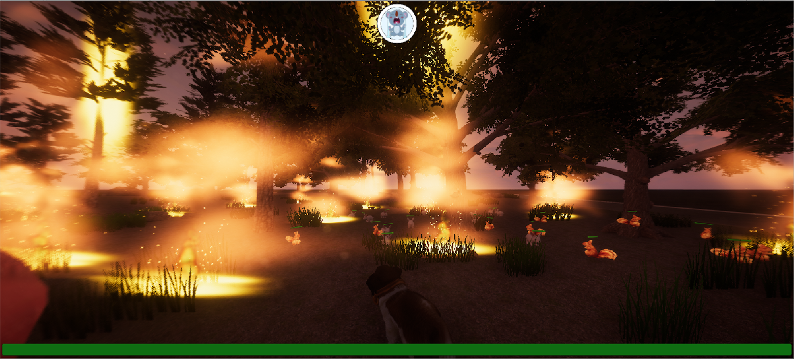

Slide 8
Training the Agent
At every step, the dog stores the following observations –
Distance between itself and the safe zone,
Distance between itself and the animals that need to be saved,
Current reward, and
Trigger update for fire

Slide 9
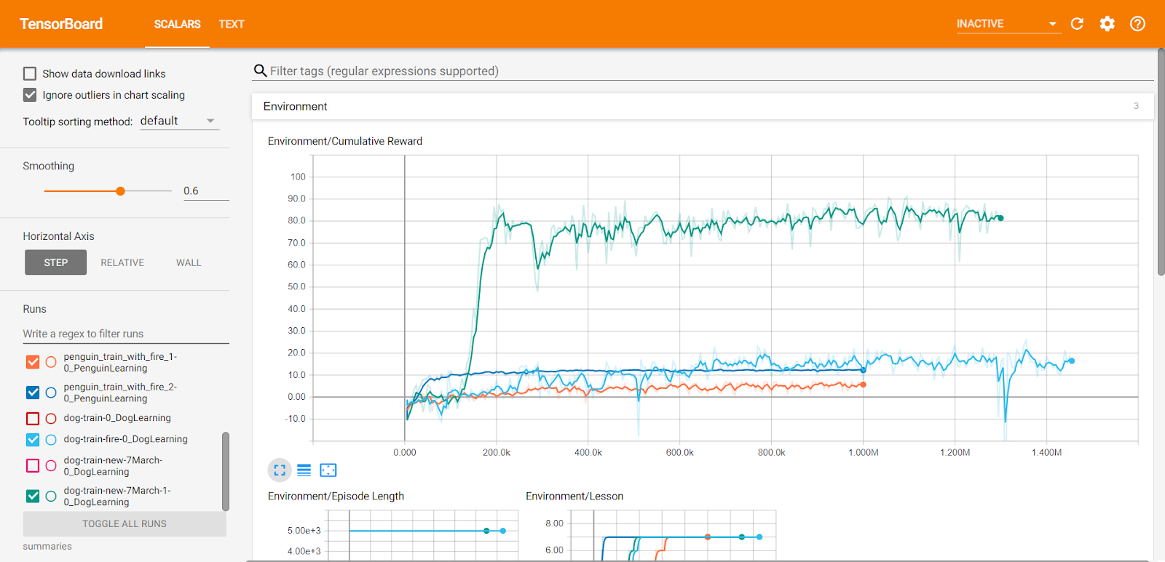

Slide 10
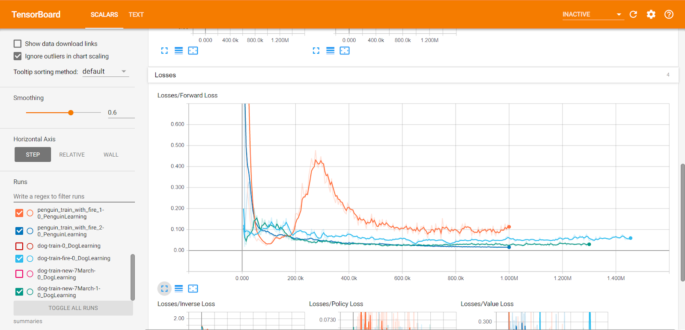

Slide 11
DEMO

Slide 12
Future Work
Improve Environment conditions.
Testing new reward signals with health parameters.
Increasing training period.
Training on new algorithms namely - Soft Actor Critic and Imitation learning.
Comparison of all environments trained with different algorithms.

Slide 13
References
[1]https://unity3d.com/get-unity/download
[2]https://github.com/Unity-Technologies/ml-agents
[3]https://github.com/Unity-Technologies/ml-agents/blob/master/docs/Installation.md
[4]https://subscription.packtpub.com/book/game_development/9781789138139/1/ch01lvl1sec14/academy-agent-and-brain
[5]https://github.com/ayushbihani/Reinforcement-Learning-for-GridWorld
[6]https://github.com/ayushbihani/Dodgeball
[7]https://www.youtube.com/channel/UC1c0mDkk8R5sqhXO0mVJO3Q
[8]https://freesound.org/
[9]https://www.logikk.com/articles/machine-learning-in-game-development/
[10]https://pathmind.com/wiki/ai-vs-machine-learning-vs-deep-learning

